Slide 1

Fraudulent and Suspicious Transactions Analysis
Detecting fraudulent transactions using Machine Learning and SQL-based analytics

Slide 2
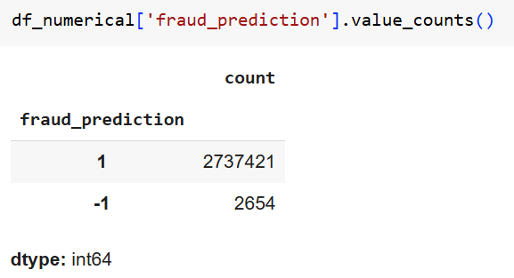
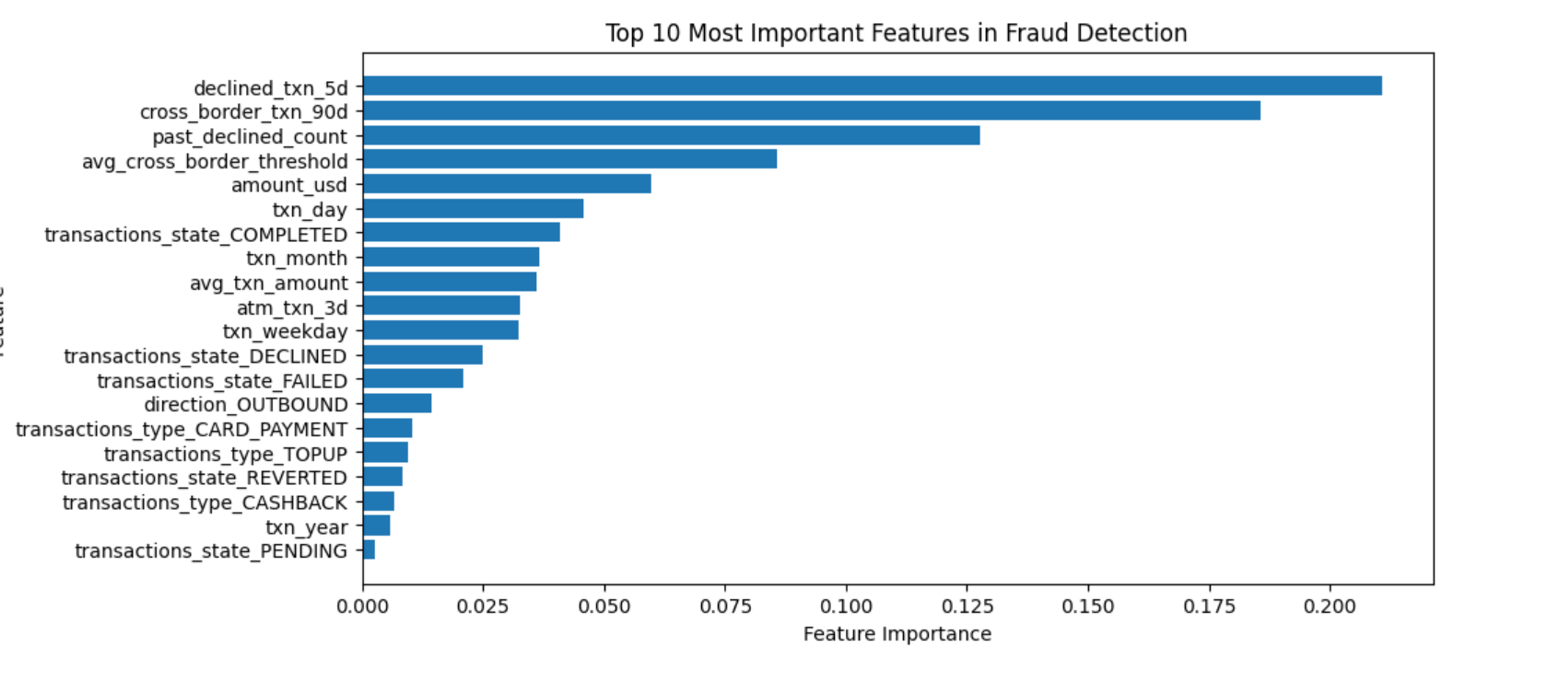
Detecting Anomalies Using Isolation Forest Algorithm
Using Isolation Forest we could analyse that 2654 transactions are fraudulent which constitutes about 0.09% of total transactions
Features I considered while training the model

Slide 3

Introduction & Objective
Why is fraud detection important?
Fraud detection is critical in financial transactions because fraudulent activities can result in significant financial losses, reputational damage, and regulatory penalties for businesses and financial institutions
Financial Loss Prevention
Customer Trust & Security
Regulatory Compliance
Early Detection & Prevention
Evolving Fraud Tactics
Why use machine Learning?
As fraudsters become more sophisticated, traditional rule-based detection methods are no longer sufficient, necessitating the use of data-driven techniques and machine learning models to identify suspicious transactions in real time

Slide 4
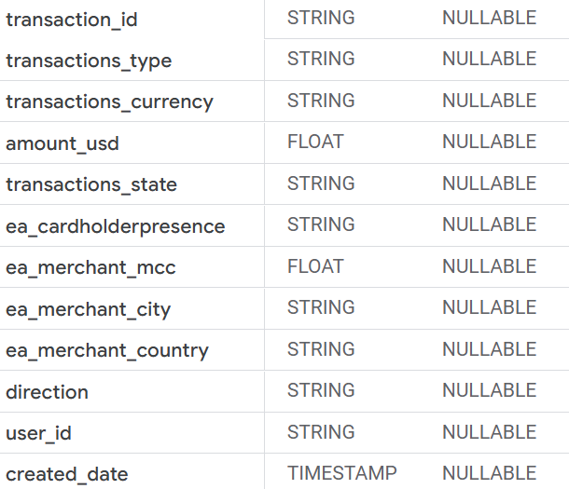
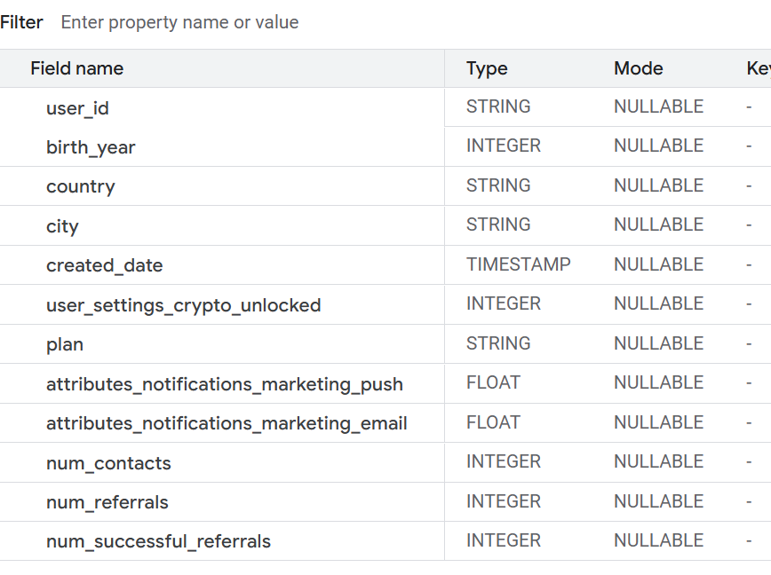
Data Collection
Sources of Data :
Data Warehouse : BigQuery
Table: Transactions and users
Types of Data Collected
Transaction Data: Amount, date, time, location, and merchant details.
User Behaviour Data: Frequency of transactions and spending habits
Key Elements considered while analysing fraudulent transactions:
Unusually High Transaction Amounts
High Declined Transaction Ratio
High Number of Reverted Transactions
Fast Consecutive Transactions
Transactions in Different Countries in a Short Time
Mismatch Between Merchant MCC and User Behaviour

Slide 5
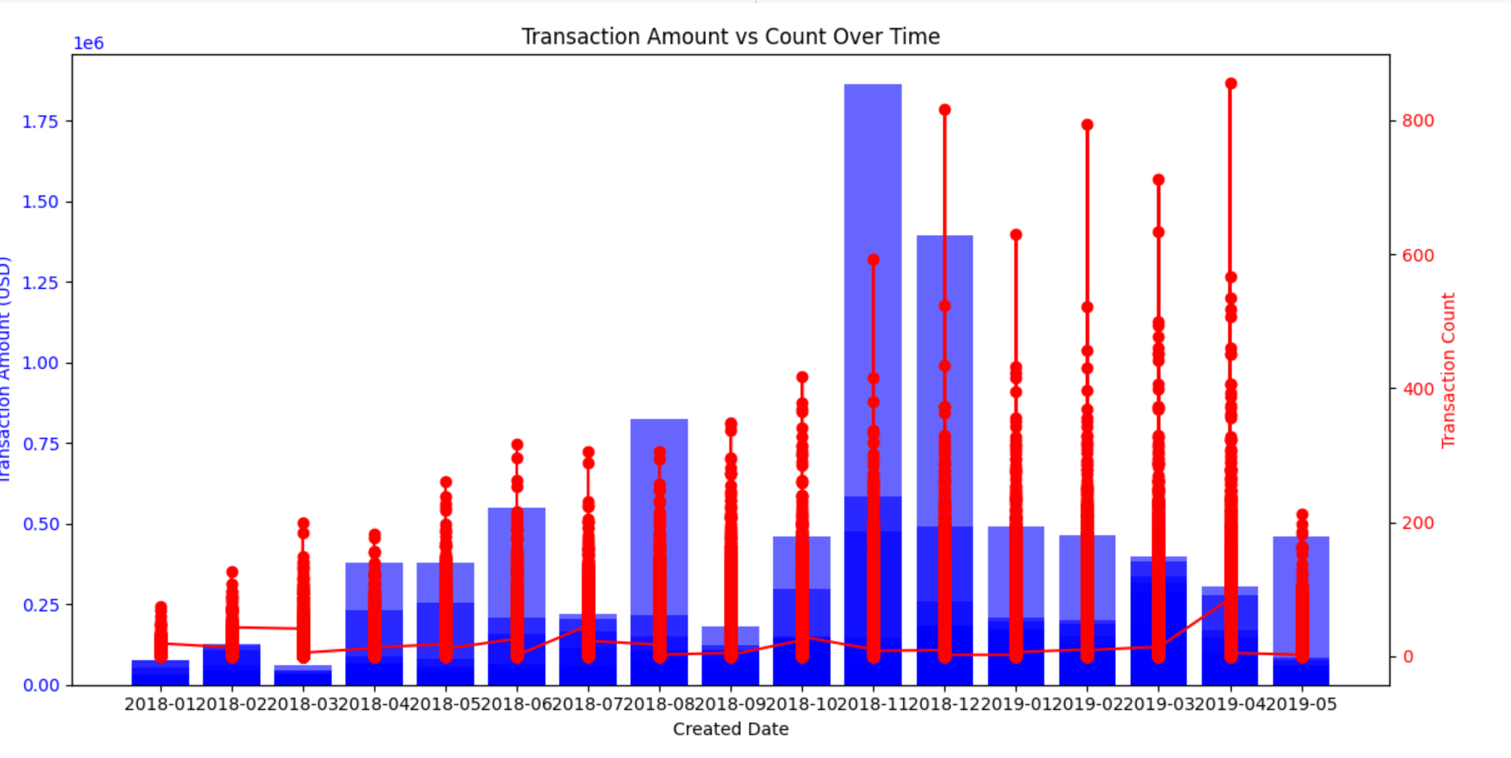
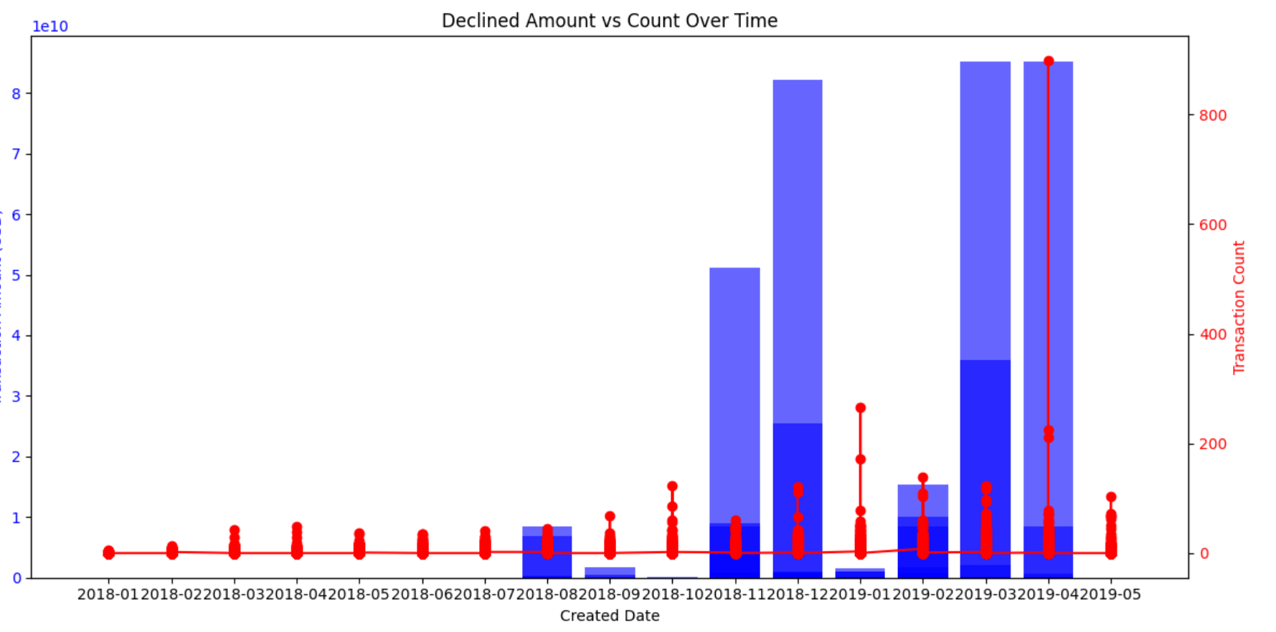
Supporting Evidences in Dataset
As we can observe the first completed transactions are completed transaction status with the completed count which is normal
In the 2nd chart we can see that there is a high value of declined transaction amount even though the count is less. This means that some users are transacting way more than usual which is suspicious

Slide 6
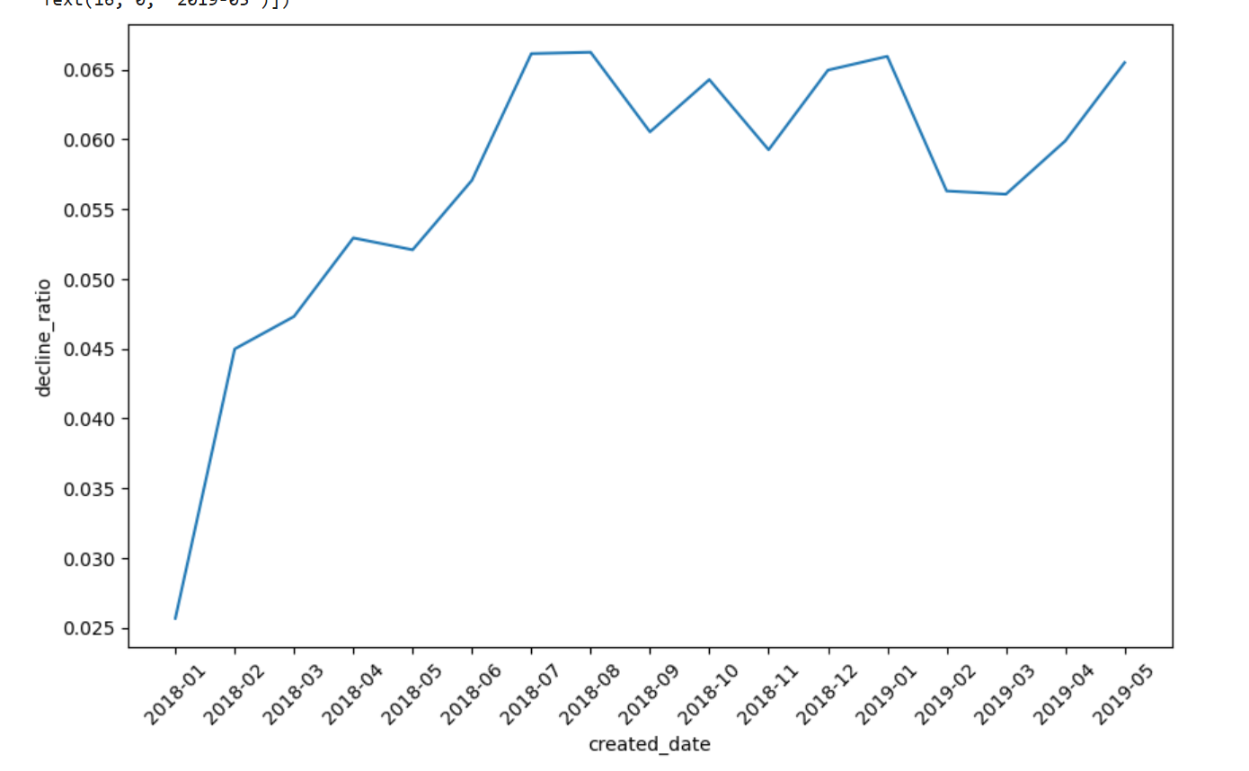
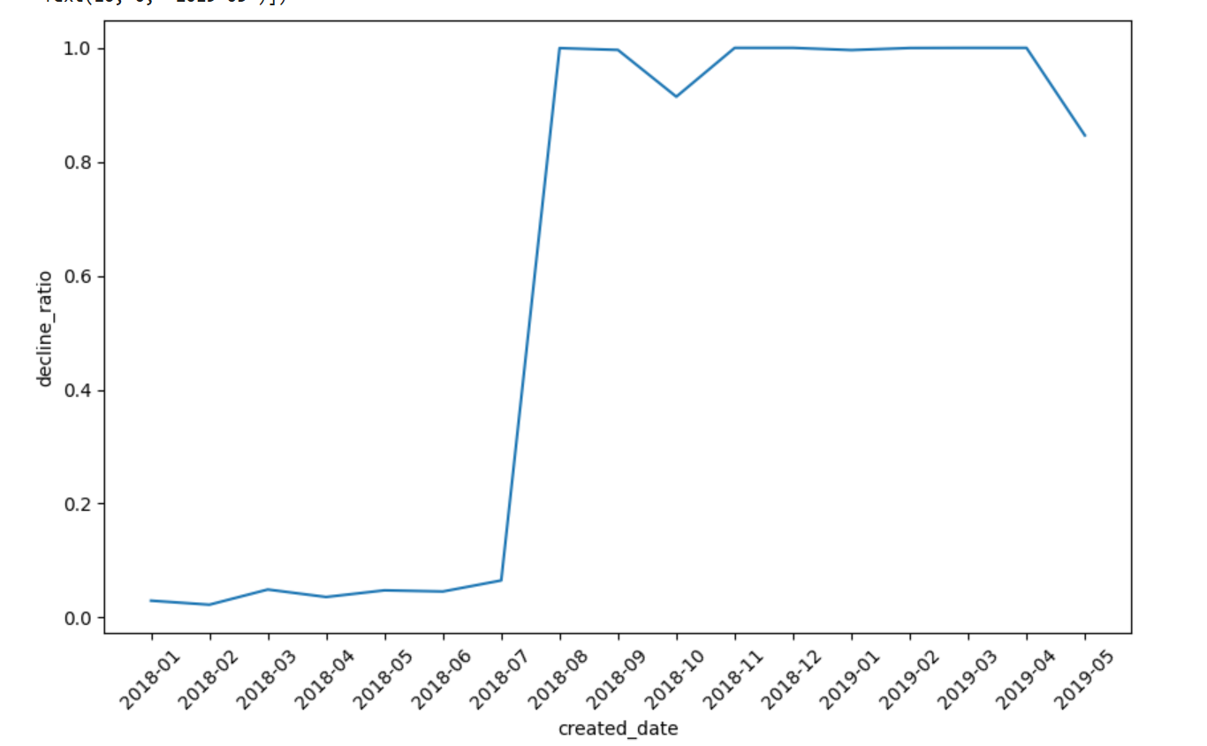
More Evidences:
Decline count ratio is increasing considerably
Decline Amount ratio has been increased as well.

Slide 7
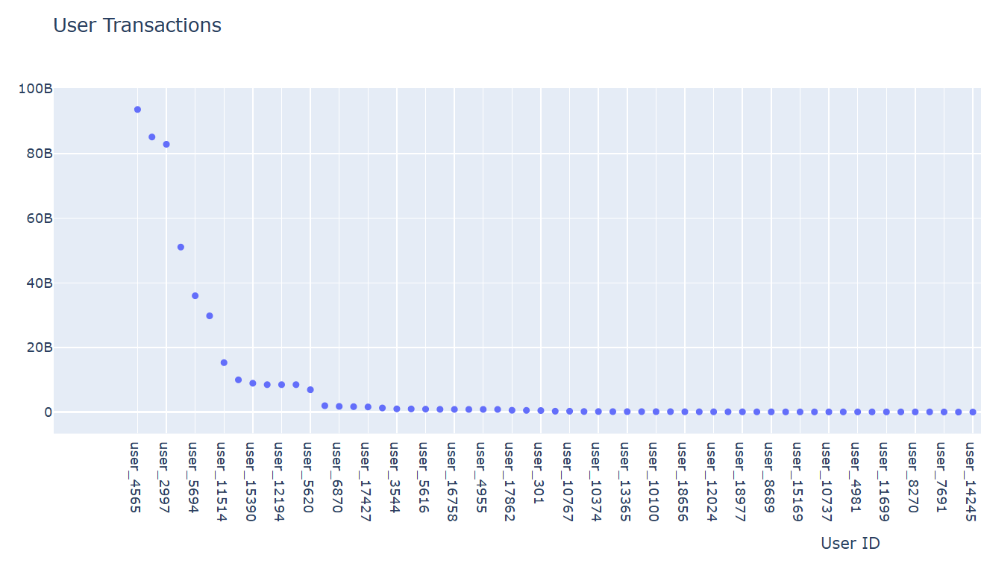
Users Declined Transactions Amount in billions

Slide 8
Insights Drawn:
Extreme Increase in Declined Transactions Before August 2018, decline amounts were in the range of 25,000 - 468,000. In August 2018, declined transactions spiked to 16 billion (!) with a 99.94% decline ratio.
The pattern continued in late 2018 and early 2019, with declines reaching 123 billion in March 2019.
The decline ratio jumped from ~6.5% in July 2018 to almost 100% in August 2018 and stayed there. This means almost all transactions were getting declined, which is highly unusual.
The last value in May 2019 (84.6% decline ratio) suggests a possible resolution or change in policy/system.

Slide 9
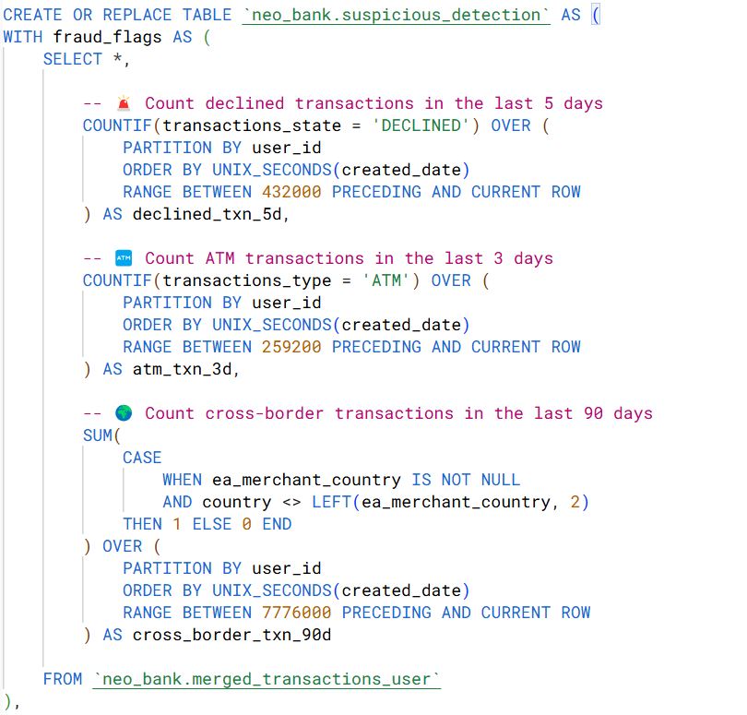
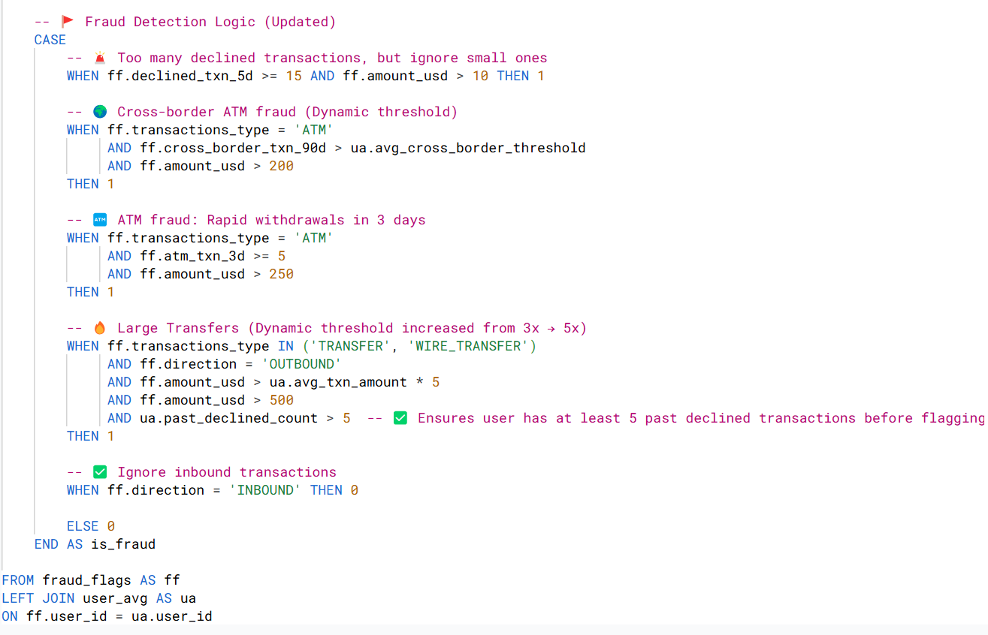
Automated script for Flagging suspicious Transactions:

